Slide 1
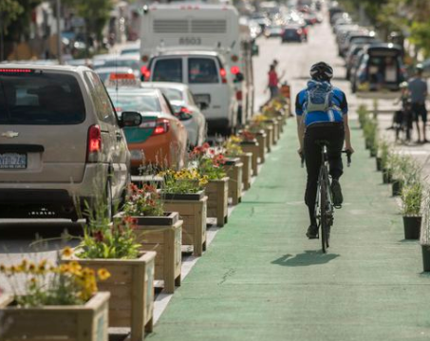
Improving Boston’s Bike Infrastructure
By:
Rami Subramaniam

Slide 2

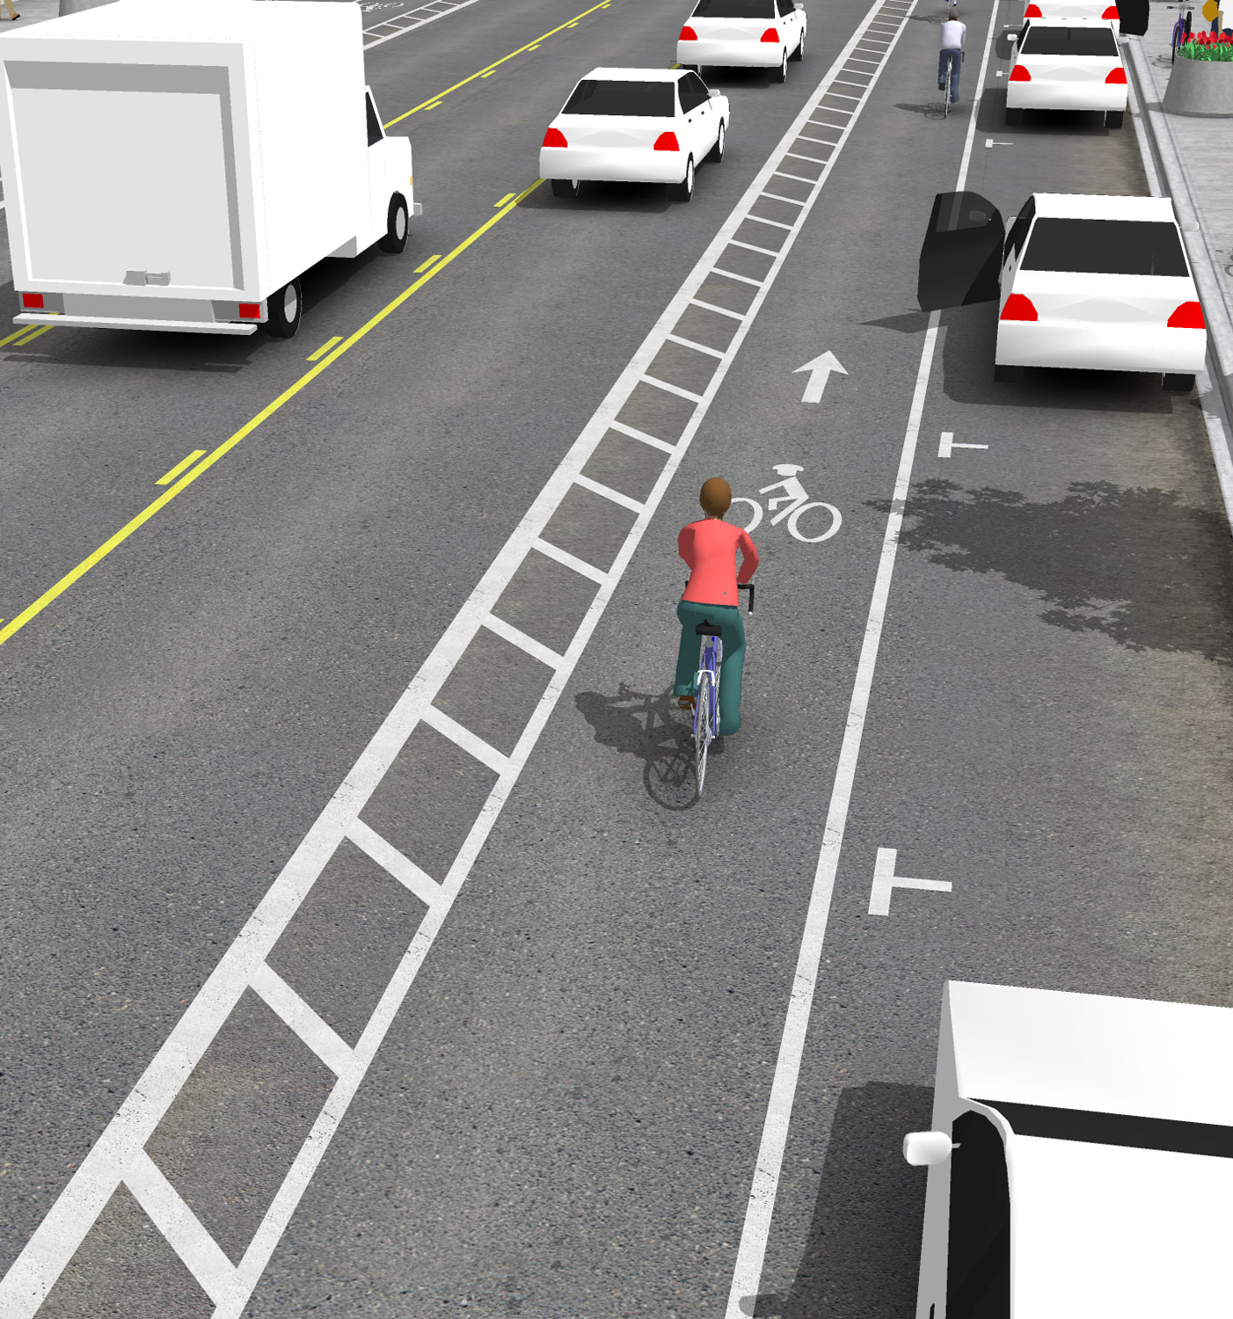
Background
Improving bike infrastructure is a big benefit to city
City has plans to build 250 miles by 2043
Median cost to build standard bike lane: $90,000/mile.

Slide 3
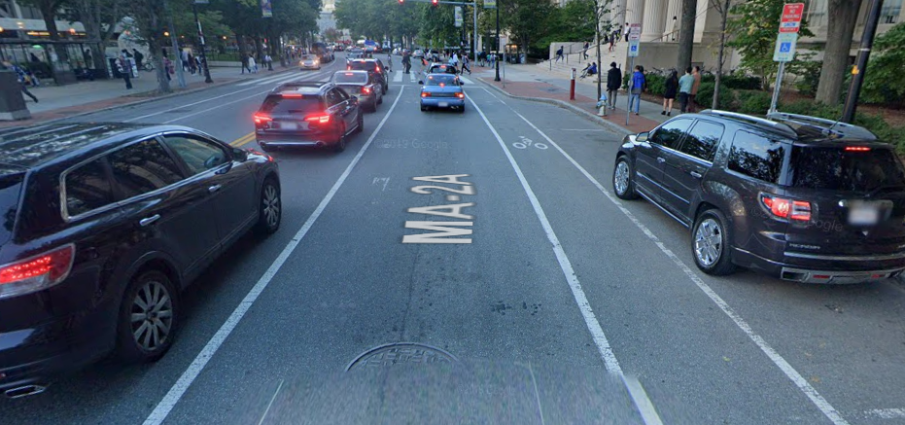
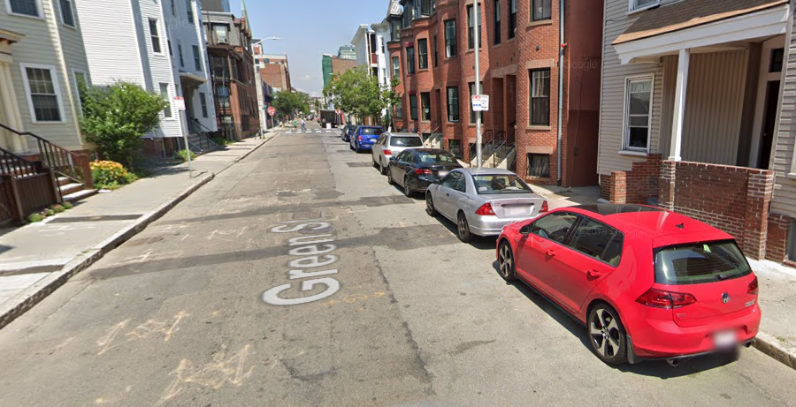
Is there a better way?
Mass Ave is a very busy street in Boston
Much calmer local street which runs directly parallel to Mass Ave
Spoken-
Instead of throwing money to just add bike lanes, the city would be much better off if we focus on roads and bike lane types which entice more bikers to actually use them
1 mile of strategically placed safe bike lane is way more effective than 5 miles of a poorly designed bike lane

Slide 4
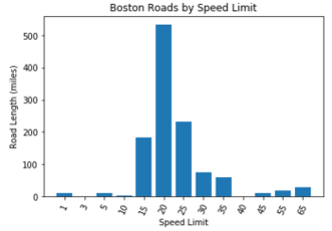
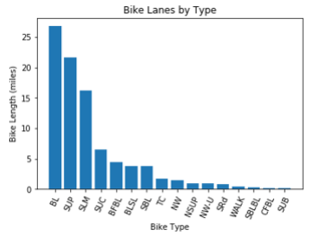
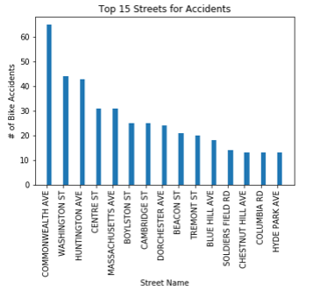
Data Source: City of Boston
Current Bike Network
Boston Street Segments
Accident data past 5 years
Goal: Build a recommendation tool which identifies:
Road segments that are ideal for adding bike lanes
Current high risk bike lanes that can be improved

